Slide 1

Genome Analysis
of
Lactobacillus paracasei
By: Analisa Coppens

Slide 2

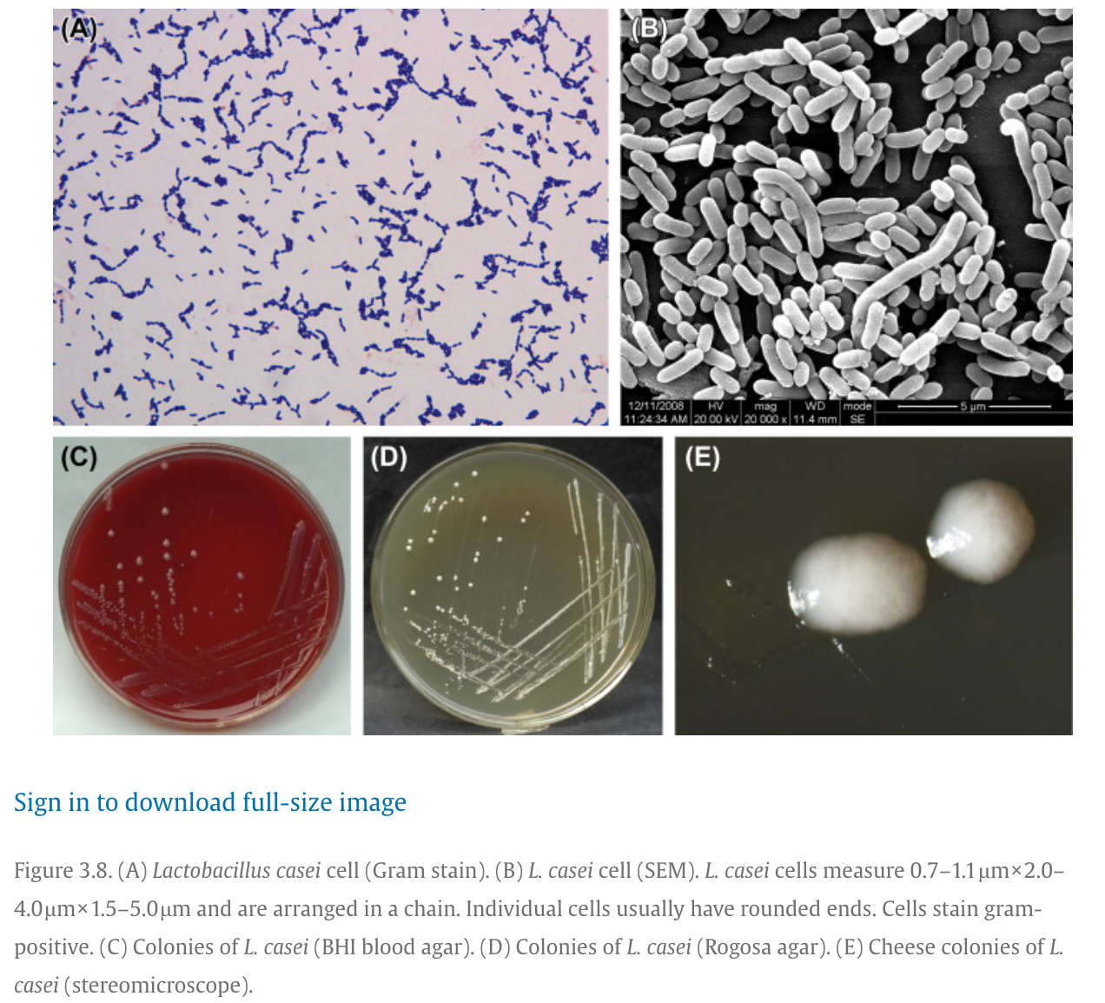
Introduction
Gut microbiome, probiotic
Importance: digestion, immunity, gut balance
Goal: Assemble, Annotate, & Compare

Slide 3
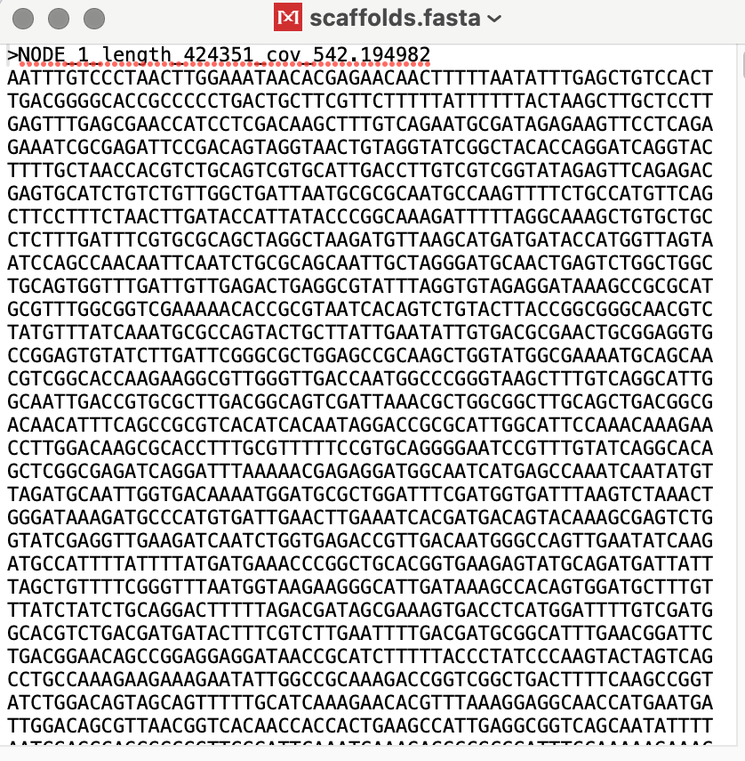
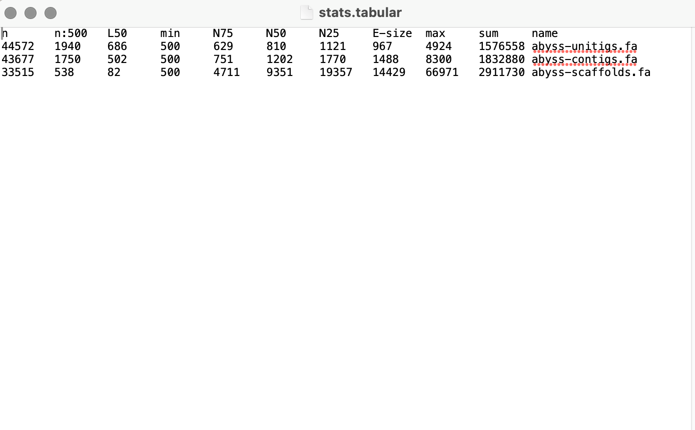
SPAdes & ABySS
Builds contigs from raw DNA reads
Abyss summarizes genome quality
-contigs
-genome length
-N50
Actual DNA output

Slide 4
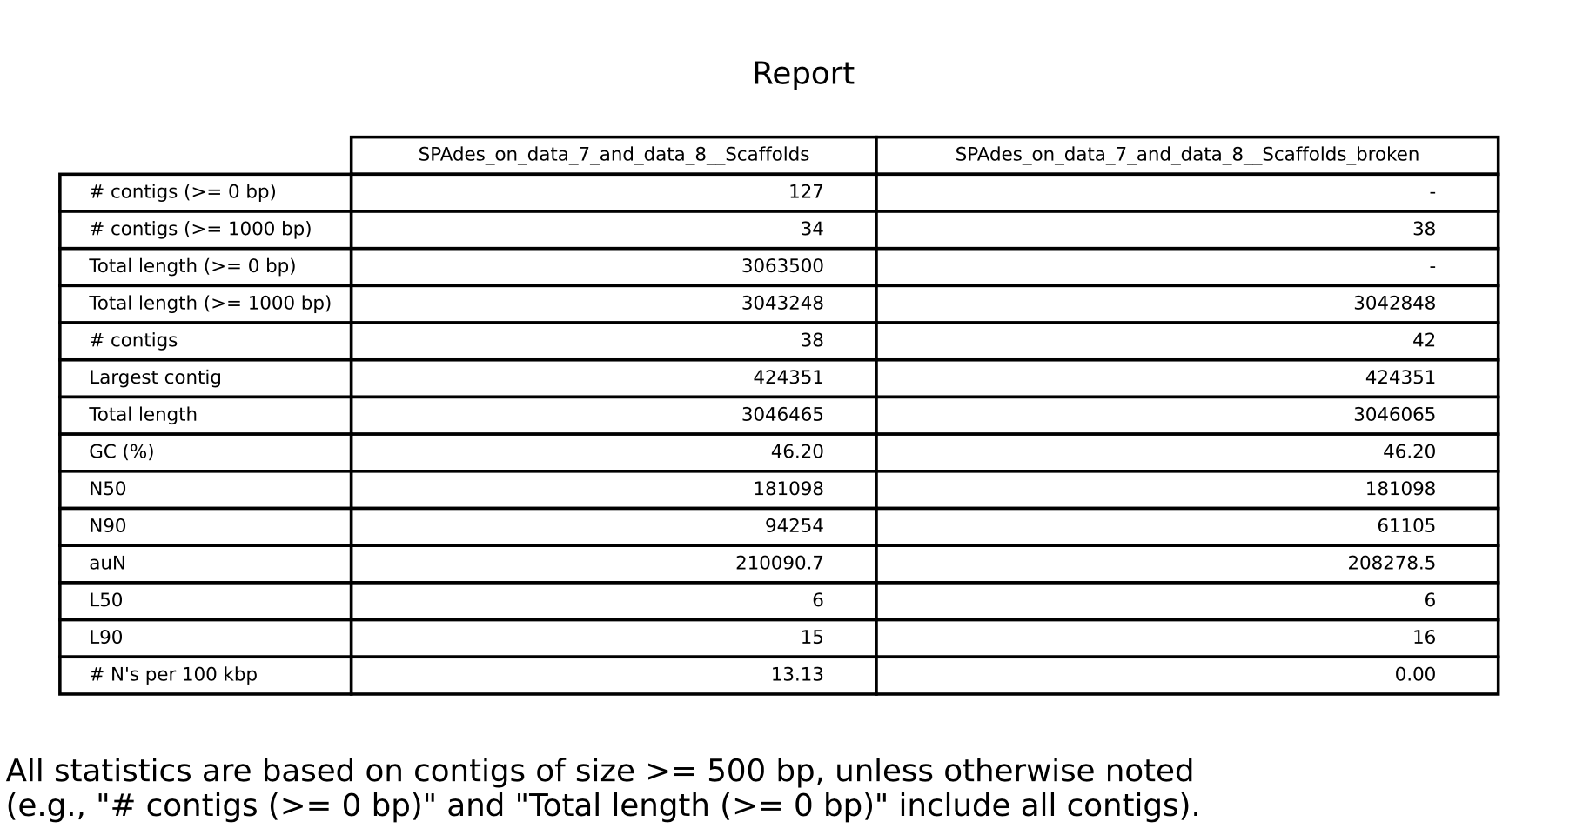
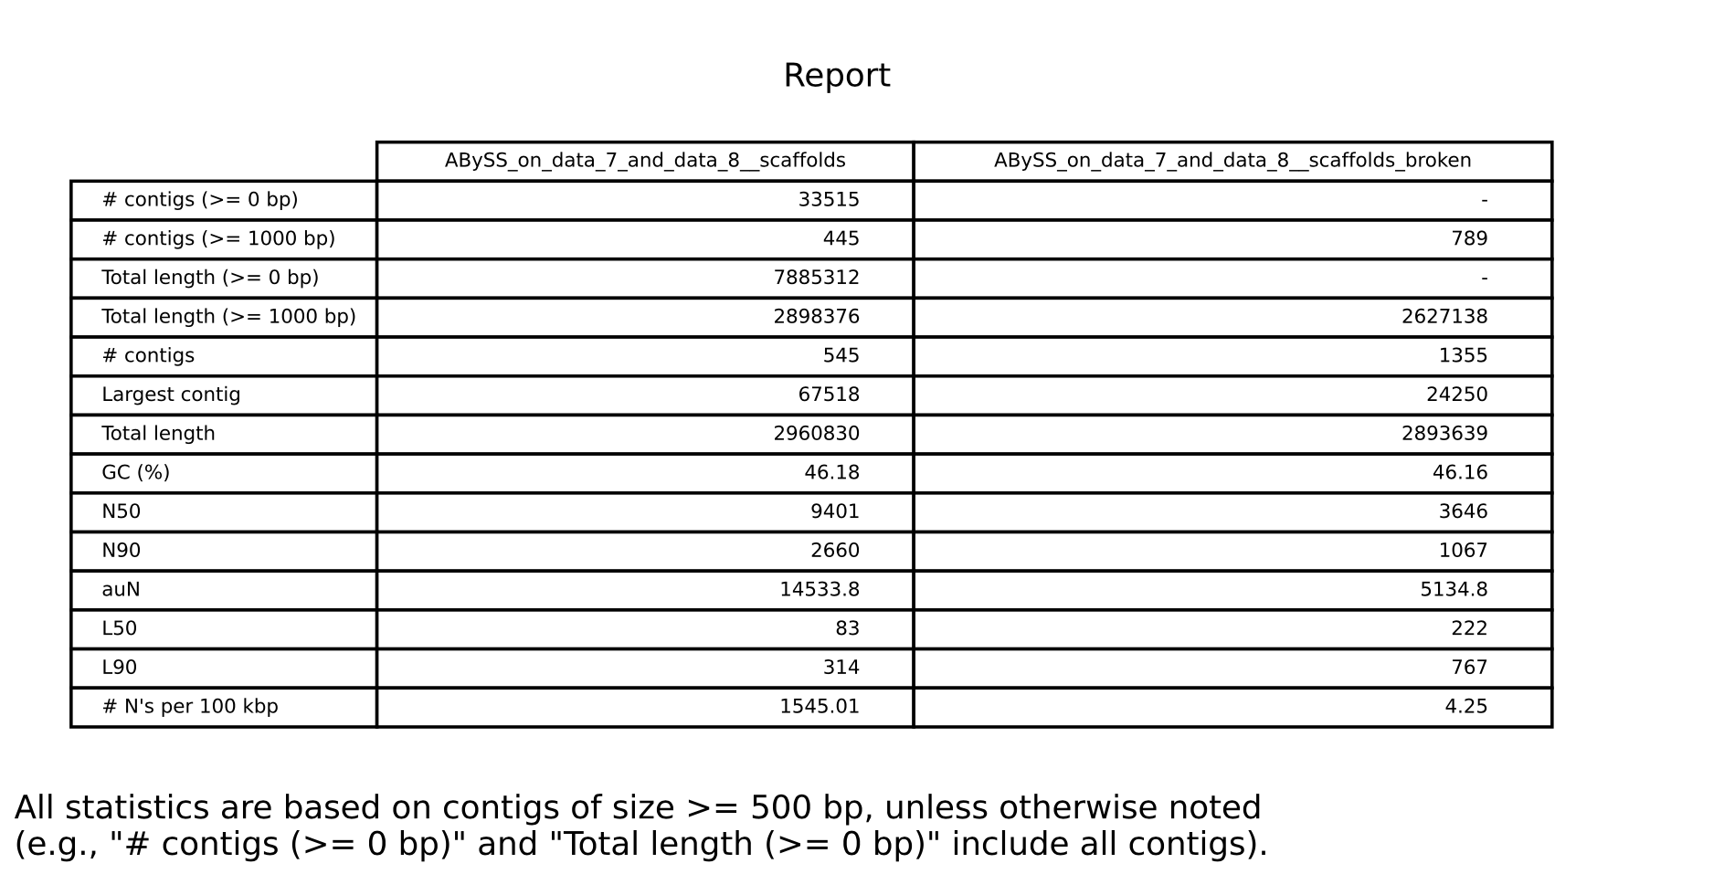
Quast
Quality Stats
N50, contigs, GC content

Slide 5
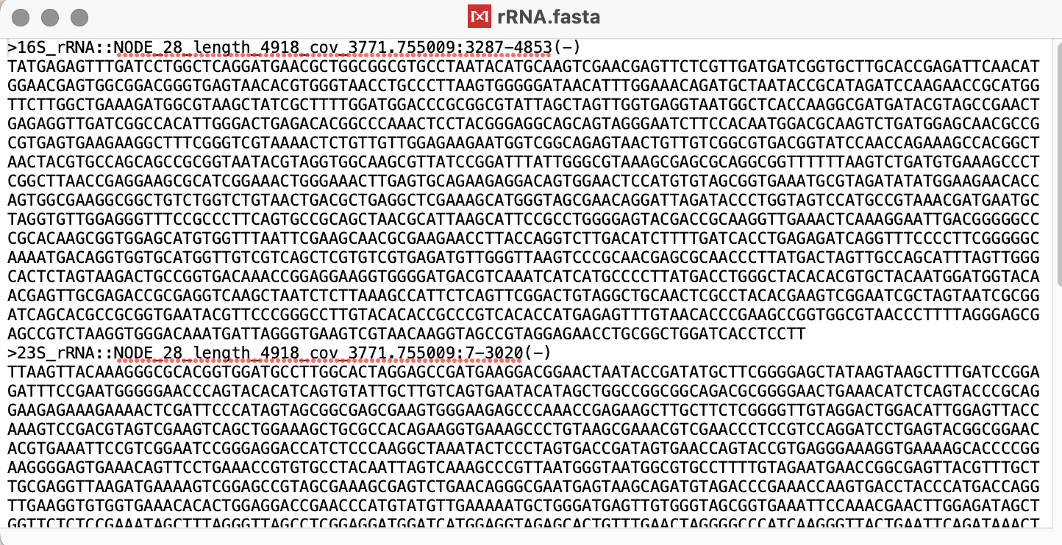
Barrnap
Identified 16S, 23S, & 5S rRNA genes
Confirms quality & species ID

Slide 6
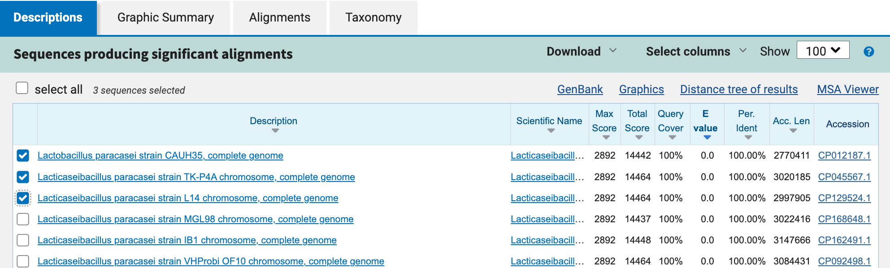
Blast
Lactobacillus paracasei strain CAUH35
Lacticaseibacillus paracasei strain TK-P4A
Lacticaseibacillus paracasei strain L14

Slide 7
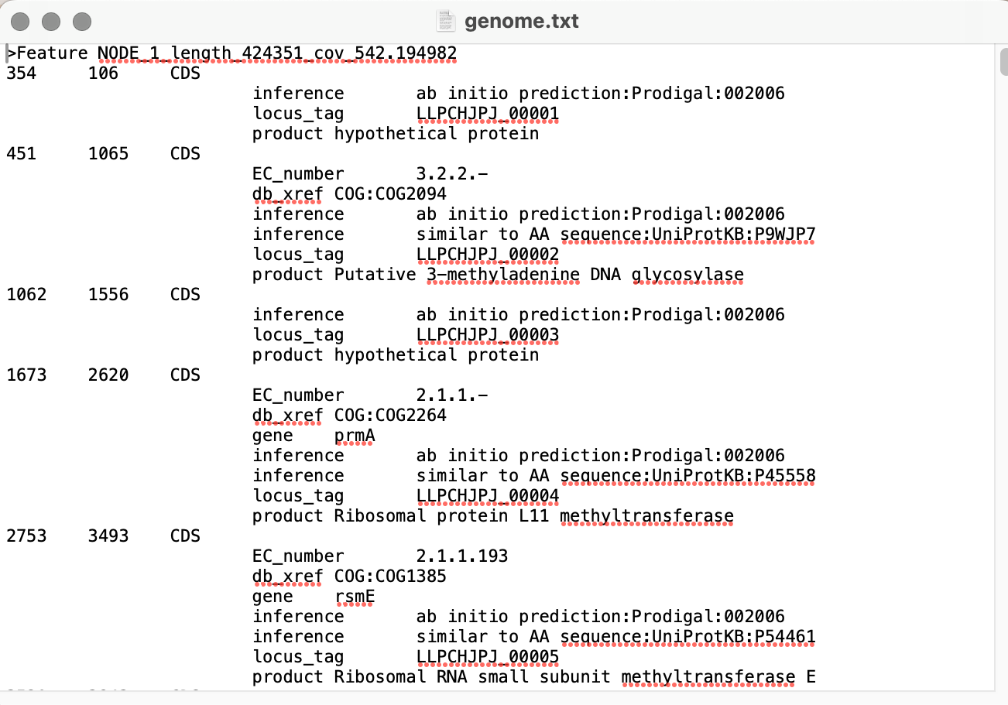
Prokka
Annotated coding sequences, rRNAs, & tRNas
Insights to predicted functions

Slide 8
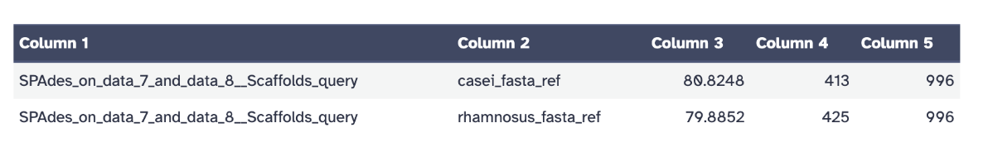
fastANI
Compared genome to references species
Identity: 80.8% & 79.8%
Confirms related but distinct species

Slide 9
Conclusion
Goal: Assemble, annotate, & compare genomes
Genome successfully assembled & annotated
Different species confirmed by FastANI

